Slide 1
Data Replication & “NoSQL”

Slide 2
Outline
Replicated Data
Transactional replication
“Relaxing” transactions
Weak Isolation
Loose Consistency & NoSQL
Replica “consistency” & linearizability
Quorums
Eventual Consistency
The Programmer’s View?

Slide 3
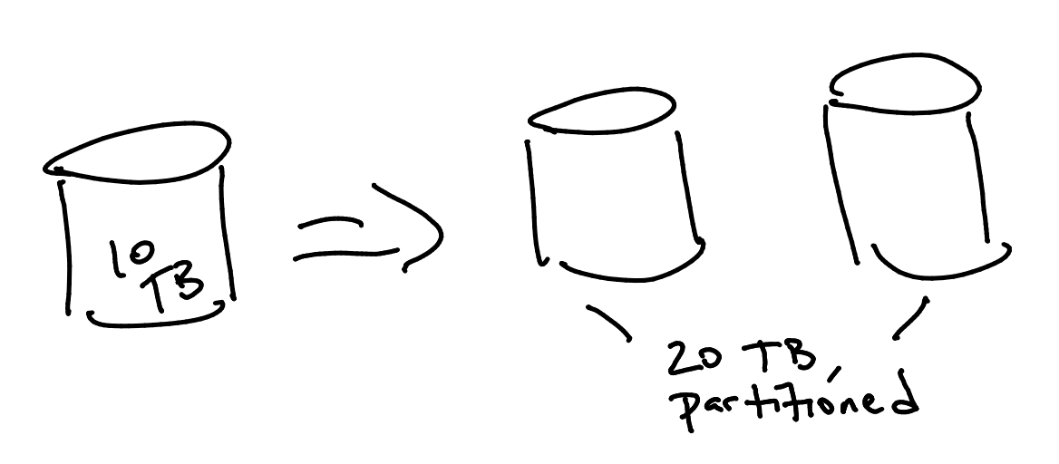
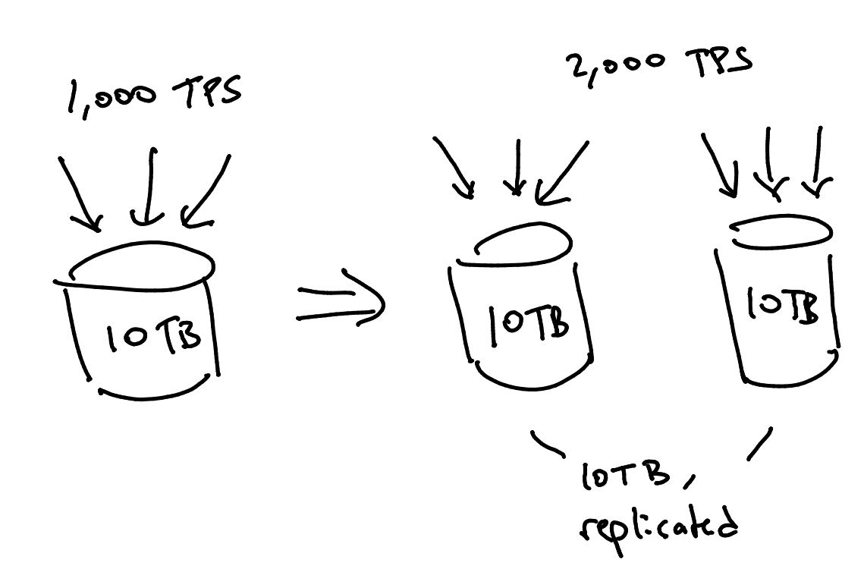
Why Replicate Data (1)? Scale.
Does NOT help with data scaling.
That’s what partitioning (“sharding”) is for!
DOES help with workload scaling!
Even on a small database
Load balancing

Slide 4
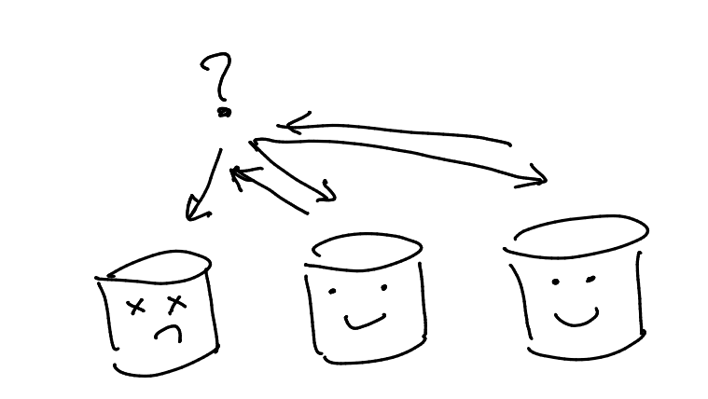
Why Replicate Data (2)? Availability
Replication increases availability
If one replica can’t answer, another can
Tolerate one node’s transient unavailability
Software crash, transient workload spike, JVM GC
Survive catastrophic failures
Avoid correlation: place replicas on a different rack, different datacenter
An “alternative” to logging
Actually, logging is a form of replication!
But full process replication recovers faster
Log-based recovery requires “interpreting” the log

Slide 5
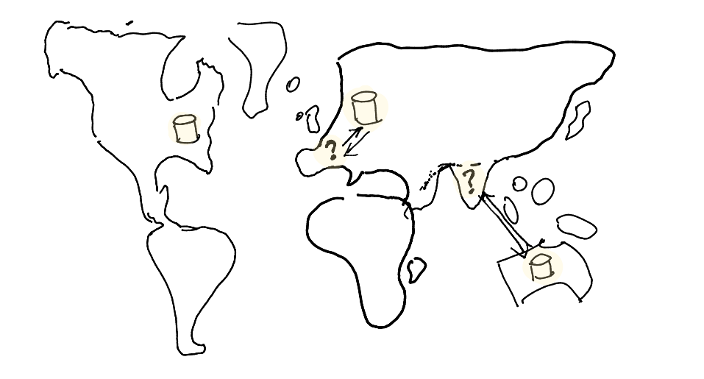
Why Replicate Data (3)? Locality
Replication reduces latency
Choose a “nearby” server
Particularly for geo-distributed DBs
Ask many servers and take the 1st response

Slide 6
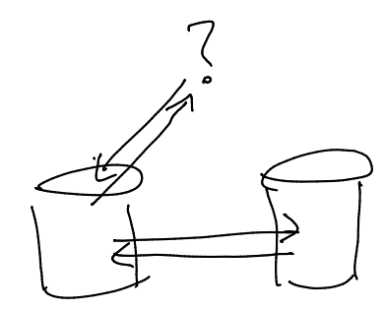
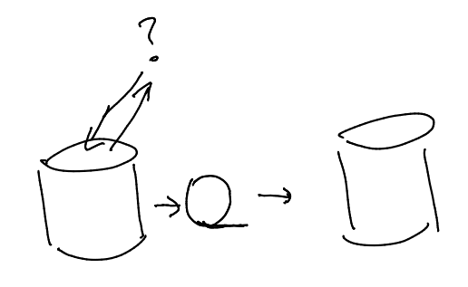
Traditional DB Replication Mechanisms 1: Single Master
Single-Master replication
“Hot Standby”
Expensive: both sides handle full update volume (at write the change needs to send update to replica)
Expensive to get transactional guarantees
How do you ensure Durable commit?
Even single-site transactions require 2PC!
Single-Master log-shipping
Cheap/free at the source node
Can be less expensive at the standby
Much lower bandwidth: diffs
Can be “hot” (via 2PC) or “warm” standby
Warm replica is a valid transactional prefix, but stale

Slide 7
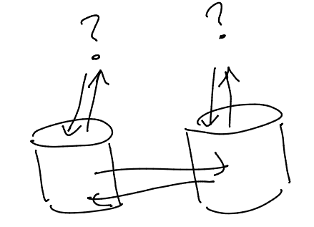
Traditional DB Replication Mechanisms 2: Multi-Master
Multi-Master
A.k.a. “Active-Active” replication
can do data-shipping or log-shipping
Writes happen anywhere
Low latency, more load balance
Can use 2PC to get copies to agree
But this causes high latency again
What happens if we don’t do 2PC?
Writes may conflict
Need rules to resolve conflicting writes
More on this later!

Slide 8
Note: Replication Details
Replication can be at various granularities:
DB, Table, Partition, Tuple
Degree and choice of replication flexible
3 is a good start
Odd, so under normal conditions, there is a “majority”
Choose locations in different “fault domains” for availability
Different racks, datacenters, continents
Replication factor could vary across objects
“hot objects” replicated to more nodes
improves read workload balancing
Some scheme needed to “route” queries to replicas
With load balance and fault tolerance
“Distributed Hash Tables”

Slide 9
Is 2PC really so expensive?
How expensive is it, really, to hold a vote?
Raw latencies depend on your network
Geo-replication and speed of light
Vs. modern datacenter switches
But best-case behavior is not a good metric!
Much depends on your machines’ delay distribution (in a Rack it is no problem, but in different data centers it is a problem)
Latency to get responses from all participants?
The max latency is the worry, not the average
“Straggler” sensitive (so-called tail latency effects)
Hardware: NW switches, mag disk vs. Flash, etc.
Software: GC in the JVM, carefully-crafted event handlers...

Slide 10
Google does 2PC; it must be good?!
Google Spanner uses 2PC and a host of other stuff
But the latencies! Speed of light.
7 times round the world per second
10 TPS!

Slide 11
Outline
Replicated Data
Transactional replication
“Relaxing” transactions
Weak Isolation
Loose Consistency & NoSQL
Replica “consistency” & linearizability
Quorums
Eventual Consistency
The Programmer’s View?

Slide 12
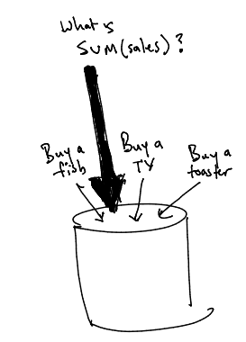
Weak Isolation
I want transactions
But serializability is not “concurrent enough”
Can’t I have some “weaker” notion?
E.g. “short” read locks?
What might that “mean”
Various (rather confusing) options commonly available in databases
See backup slides

Slide 13
Outline
“Relaxing” transactions
Weak Isolation
Loose Consistency & NoSQL
Replica “consistency” & linearizability
Quorums
Eventual Consistency
The Programmer’s View

Slide 14

Hamilton Quote on Coordination
“The first principle of successful scalability is to batter the consistency mechanisms down to a minimum, move them off the critical path, hide them in a rarely visited corner of the system, and then make it as hard as possible for application developers to get permission to use them”
—James Hamilton (IBM, MS, Amazon)

Slide 15
A Definition: Replica Consistency
Replica Consistency
Illusion: all copies of item X updated together, atomically
Really: readers see values of X that they would see without concurrency
Linearizability (a.k.a. “Atomic Consistency”)
Notes
Not to be confused with the “C” in ACID!
This overloading has caused endless headaches
Not to be confused with serializability
Actions only; not transactions. Single-object writes
Deterministic ordering: writes on a given key are seen in the “real-time” order requested
Vs. “equivalent to some serial schedule”: non-deterministic
You can layer serializable concurrency control on top of linearizable replicated stores

Slide 16
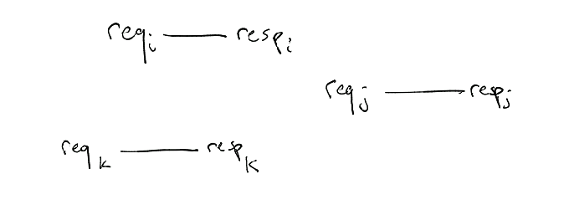
Digging Deeper: Linearizability
i
j
History:
Set of request/response pairs
Linear History
A history with immediate responses to requests
Linearizable Equivalence
History h1 equiv to h2 if:
Same set of requests/responses
If response_{i} precedes request_{j} in h1, the same in h2
Linearizable History
Linearizably equivalent to Linear History
I.e. A fixed order of atomic request/response pairs
k
time

Slide 17
Quorum Consistency
Assume writes are globally timestamped
<local-clock, node-ID> to break clock ties
Want to ensure that all readers see the same (“consistent”) value
Even in the face of delayed replication
Again: this is NOT the C in ACID!! It’s linearizability.
Idea 1: Write to All
Can read any 1 copy and get the “latest”

Slide 18
Quorum Consistency
Assume writes are globally timestamped
<local-clock, node-ID>
Want to ensure that all readers see the same (“consistent”) value
Even in the face of delayed replication
Again: this is NOT the C in ACID!! It’s linearizability.
Idea 1: Write to All
Can read any 1 copy and get the “latest”
Idea 2: Read from All
Can write “latest” to any copy

Slide 19
Quorum Consistency
Assume writes are globally timestamped
<local-clock, node-ID>
Want to ensure that all readers see the same (“consistent”) value
Even in the face of delayed replication
Again: this is NOT the C in ACID!! It’s linearizability.
Idea 1: Write to All
Can read any 1 copy and get the “latest”
Idea 2: Read from All
Can write “latest” to any copy
Idea 3: Read & Write a majority
Read guaranteed to see “latest” on at least one node

Slide 20
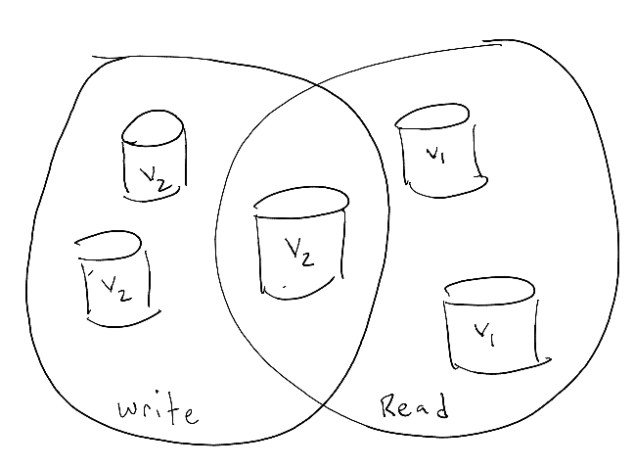
Quorum Consistency
More generally:
Write to a write-quorum of w nodes
Read from a read-quorum of r nodes
Ensure r + w > N (#nodes)
Optional: ensure w > N/2 and you don’t need write timestamps: no w/w race conditions
Assumption (big!)
The set of nodes in the system (membership) is static
How do we handle failures? New nodes?
Take a distributed systems class!

Slide 21
Relaxing Replica Consistency
With that background, here comes the Internet!
And increasingly, the Cloud
Suddenly, we’re all using global-scale infrastructure. (??)

Slide 22
Update-heavy Global-Scale Services
E.g. Amazon, Facebook, LinkedIn, Twitter
Shopping, Posting and Connecting
Latency and Availability both paramount
Replication is critical
Favors multi-master solutions, with loose quora
Replica consistency becomes frustrating
See Hamilton quote
Becomes quite natural to ditch replica Consistency!
Even linearizability is too expensive! (?)
All the more so serializability!!
The rise of NoSQL

Slide 23
NoSQL
Really two rejections:
Say No! to schemas and declarative queries
Not agile to have to define schemas in advance
SQL is a “hoop to jump through” from my “real” language
Instead, key-value stores
put(key, val). val = get(key)
Sometimes the values are (JSON) documents
Notably MongoDB
Say No! to serializable transactions
Much easier to scale massively without them!
Replicate aggressively, with multi-master writes
No 2PC: Don’t worry about partial failure
Many use cases don’t need multi-object transactions
Because I’m just “sticking a stuff in the database”

Slide 24
NoSQL ambiguities
Per-object ambiguities (no linearizability)
You may not read the latest version
Multi-master, Writers can conflict
Write the same key in different places
‘Conflict Resolution’ or ‘Merge’ rules apply:
E.g. Last/First writer wins
But what clock do you use?
E.g. Semantic merge (e.g. Increment)
E.g. keep all values in a set (and let application decide)
Across objects (no serializability)
Typically no guarantees
No notion of “trans”-actional semantics

Slide 25
“Eventual Consistency”
“if no new updates are made to the object, eventually all accesses will return the last updated value”
-- Werner Vogels, “Eventually Consistent”, CACM 2009
Which in practice means...??

Slide 26
Problems with E.C.
Two kinds of properties people discuss in distributed systems:
Safety: nothing bad ever happens
False! At any given time, the state of the DB may be “bad”
Liveness: a good thing eventually happens
Sort of! Only in a “quiescent” eventuality.
Arguably most EC systems service a collection of “sessions”, each of which quiesces in the real world

Slide 27
The State of NoSQL Today
No Schemas or Declarative Language
Schema flexibility adopted in relational DBMSs
Declarative SQL-like languages now common in NoSQL systems
E.g. Cassandra and MongoDB both have query languages
K/V and JSON support now common in RDBMSs
See PostgreSQL JSON support
RDBMS queries over schema-less files increasingly common as well
Redshift Spectrum, Postgres FDW, etc.
No Serializable Transactions
Still true in most NoSQL systems
Eventual Consistency models still evolving
More on this next

Slide 28
Outline
Replicated Data
Transactional replication
“Relaxing” transactions
Weak Isolation
Loose Consistency & NoSQL
Replica “consistency” & linearizability
Quorums
Eventual Consistency
The Programmer’s View?

Slide 29
How do programmers deal with EC?
What, me worry? (You don’t care)
Application-level coordination
The application needs to manage race conditions in its own (often parallel) setting
Provably consistent code: monotonicity
The application can be written in a language or framework where all messages are reorderable without affecting outcomes
We’ll get to this shortly

Slide 30
Case Study: The Shopping Cart
Based on Amazon Dynamo
With the global 2PC commit order “clock”

Slide 31



Key | Value
Key | Value

Slide 32

-1
-1
Key | Value
Key | Value

Slide 33

Key | Value
Key | Value
1
1
1
1

Slide 34

Key | Value
Key | Value
1
1
1
1

Slide 35

Key | Value
Key | Value
1
1
1
1
1
1

Slide 36
Key | Value
Key | Value
1
1
1
1

Slide 37
Key | Value
Key | Value
2
2
✔
1
1

Slide 38
Eventually Consistent Version
What could go wrong?

Slide 39
-1
-1
Item | Count
Item | Count
0
1
1
2
1
1
1
1

Slide 40

What, me worry?
How often does inconsistency occur?
E.g. What are the odds of a “stale read”?
P.B.S. Study at Berkeley (pbs.cs.berkeley.edu)
Based on LinkedIn and Yammer traces
Stale reads are pretty rare
Esp in a single datacenter, using flash disks
But they happen!
What’s a programmer to do?
In terms of understanding exceptions
What problems could they cause in the application layer?
In terms of exception detection/handling (“apologies”)

Slide 41
Application-level Reasoning (how amazon does it)
The most interesting part of the Dynamo paper is its application-level smarts!
Basic idea:
Don’t mutate values in a key-value store
Accumulate “action” logs at each node monotonically
Union up a set of actions (grows monotonically)
Union is commutative/associative!
Only coordinate for checkout

Slide 42
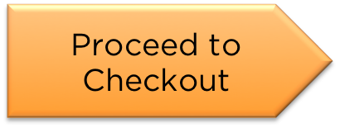
Notes:
Barrier at Checkout

Slide 43
Monotonic Logic
Merge things “upward”
sets grow bigger (merge: Union)
counters go up (merge: MAX)
booleans go from false to true (merge: OR)
Also for the interesting merges:
Commutative
A merge B = B merge A
Associative
(A merge B) merge C = A merge (B merge C)
Idempotent
A merge A = A

Slide 44
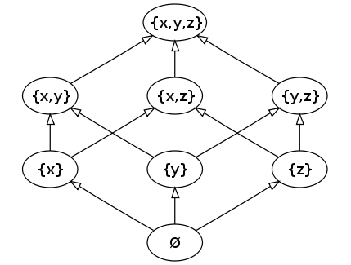
General Monotonicity
Merge things “upward”
sets grow bigger (merge: Union)
counters go up (merge: MAX)
booleans go from false to true (merge: OR)
Can be partially ordered
E.g. sets growing
Note why this works!
Associative, Commutative, Idempotent
Core mathematical objects
Lattices & Monotonic logic
E.g. Select/project/join/union. But not set-difference, negation

Slide 45
CALM Theorem
When can you have consistency without coordination?
Really.
I mean really. Like “complexity theory” really.
I.e. given application X, is there any way to code it up to run correctly without coordination?
CALM: Consistency As Logical Monotonicity
Programs are eventually consistent (without coordination) iff they are expressible in monotonic logic.
Monotonicity => coordination can be avoided (somehow)
Non-monotonicity => coordination required

Slide 46
Example
The fully monotone shopping cart

Slide 47

✔
✔
A “seal” or “manifest”
Notes:
Barrier at Checkout

Slide 48
The Burden on App Developers
Given the tools you have
Java/Eclipse, C++/gdb, etc.
Convince yourself your app is correct
No race conditions? Fault tolerant?
Convince yourself your app will remain correct
Even after you are replaced
Convince yourself the app plays well with others
Does your eventual consistency taint somebody else’s serializable data?
Wow. OK. Do you miss transactions yet?
Amazon reportedly replaced Dynamo
Transactions increasingly practical in a datacenter
But what about global, high-performance systems?

Slide 49
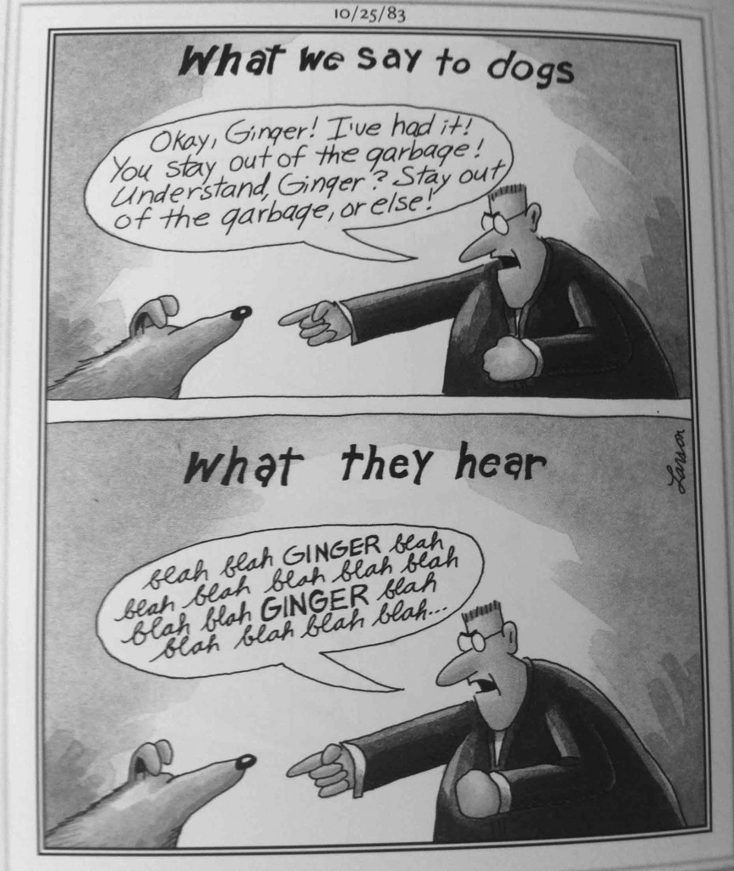

Slide 50
databases
Buy two apples and an orange
Read Write Read Write Read Write..
With thanks to Peter Bailis

Slide 51
Shameless plug #1: <~ bloom
If you know your application you can avoid coordination
Really good programmers do this!
Maybe
Everyone else needs a better programming model
One that encourages monotonicity, and analyzes for it.
E.g. bloom (http://bloom-lang.net)
+ Confluence analysis (Blazes)
+ Fault Tolerance analysis (Molly)
Etc.
See http://boom.cs.berkeley.edu
We are still working on these ideas in my group

Slide 52
Popular NoSQL Systems
MongoDB, Redis, Hbase, Cassandra, Couchbase, Voldemort, Riak, etc. etc.
Why so many?
Not all that hard to build
Lack of standards, design alternatives
Interesting to compare to Hadoop/Spark
Why is there no NoSQL core? Cause or effect?

Slide 53
Shameless Plug #2: Anna
A system that scales across orders of magnitude
Because it’s fully shared-nothing, coordination-free
Even across threads!
No locks, no atomic instructions, no coordination protocols.
On crazy performance benchmarks:
800x faster than Intel’s “lock-free” main-memory hash table
700x faster than the Masstree KVS from Harvard
On more realistic Yahoo Benchmarks
10x faster than Redis on a single node
10x faster than Cassandra across the globe
Many levels of consistency available
Uses lattice compositions to achieve many interesting consistency levels from research literature

Slide 54
Should you be using NoSQL?
Data model and query support
Do you want/need the power of something like SQL?
And are your queries canned, or ad-hoc?
Do you want/need fixed or flexible schemas
Note that you can put flexible data into a SQL database
Scale
Do you want/need massive scalability and high availability?
What’s your data volume? Update/query workload?
Are you committed to multi-master writes?
Will you need geo-replication
Are you willing to sacrifice replica consistency?
Agility and growth
Are you building a service that could grow exponentially?
Optimizing for quick, simple coding?
Or maintainability?

Slide 55
Summing Up
Partitioning provides Scale-Up
Can also partition lock tables and logs
Replication provides workload scaling, availability
Can be done serializably, or linearizably
If not, new “consistency” challenges and compromises
NoSQL is a playpen for exploring loosely consistent replication
Avoiding coordination scales up beautifully
Can you avoid coordination and get correct programs?

Slide 56
Backup material

Slide 57
Weak Isolation: Motivation
Even on a single node, sometimes transactions seem too restrictive
The Chancellor requests the average GPA of all students
Various Profs want to make individual updates to grades
Can’t we all just get along?
Sometimes transactions seem too expensive
E.g. 2PC requires computers to wait for each other
Must transactions be “all or nothing”?
Can’t we have “loose transactions” or “a little bit of” transactions
Short Answer (tl;dr):
Yes, but the API for the programmer is hard to reason about.
Still, many people adopt “don’t worry be happy” attitude

Slide 58
SQL Isolation Levels (Lock-based)
Read Uncommitted
Idea: can read dirty data
Implementation: no locks on read
Read Committed
Idea: only read committed items
Implementation: can unlock immediately after read
Cursor Stability
Idea: ensure reads are consistent while app “thinks”
Implementation: unlock an object when moving to the next
Repeatable Read
Idea: if you read an item twice in a transaction, you see the same committed version
Implementation: hold read locks until end of transaction
No phantom protection
Serializable

Slide 59
Snapshot Isolation (SI)
All reads made in a transaction are from the same point in (transactional) time
Typically the time when the transaction starts
It’s like a “snapshot” from start time
Transaction aborts if its writes conflict with any writes since the snapshot.
When implemented on a MultiVersion system, this can run very efficiently! Oracle pioneered this. Postgres also implements it.
Fact 1: This is not equivalent to serializability.
Fact 2: Oracle calls this “serializable” mode.

Slide 60
SI Problem: Write Skew
Checking (C) and Savings (S accounts)
Constraint: C_{i} + S_{i} >= 0
Begin: C_{i} = S_{i} = 100
T1: withdraw $200 from C_{i}
T2: withdraw $200 from S_{i}
Serial schedules:
T1; T2. Outcome: ??
T2; T1. Outcome: ??
SI schedule:
?? !!

Slide 61
Bad News
The lock-based implementations don’t exactly match the SQL standards
They do uphold the ANSI standards
But the official SQL definitions are (unintentionally) somewhat more general
Upshot:
It’s very hard to reason about the meaning of weak isolation
Usually people resort to thinking about the implementation
This provides little help for the app developer!

Slide 62
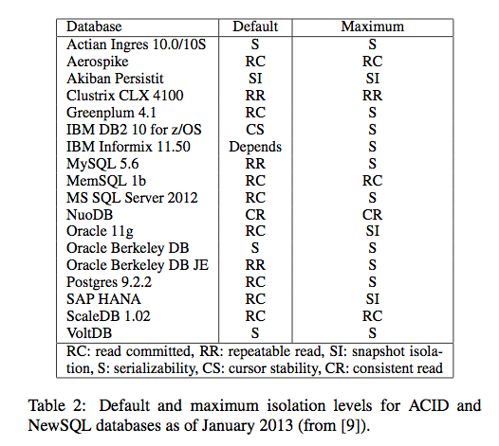
Worse News!

Slide 63
Worse News!
With thanks to Peter Bailis

